Slide 1
Self-Supervised learning for Medical Image Analysis using Image Context Restoration Liang Chen, Department of Computing, Imperial College London Paul Bentley, Department of Medicine, Imperial College London Kensaku Mori, Graduate School of Informatics, Nagoya University, Japan July 2019 MICCAI, Medical Image Analysis

Slide 2
Background
Supervised Learning: Large amount of labeled data.
Unsupervised Learning: Clustering with unlabeled data.
Semi-supervised Learning : Small amount of labeled data.
Self-supervised Learning : Unsupervised Learning. Using pretext to help learn semantic image features to initialize the subsequent task.

Slide 3
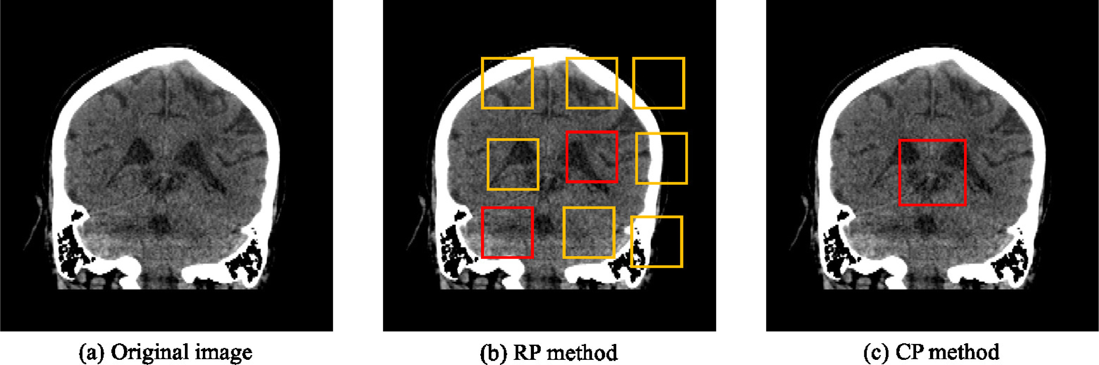
Background
RP Method: Prediction of the relative positions of image patches.
CP Method: Local context prediction.

Slide 4
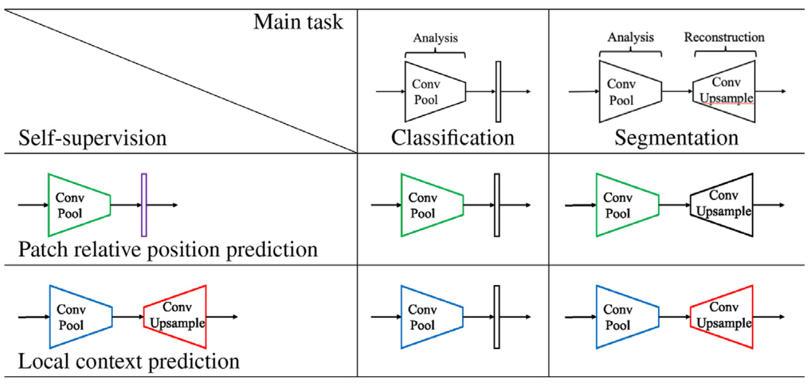
Shortcomings
RP Method: 1. Multi result, 2. Trivial features, 3. Missing global context.
CP Method: Removal changes the feature distribution.
Notes:
RP Shortcomings：1.relative position has multi result. 2.CNN learn trivial features. 3. not whole picture.

Slide 5
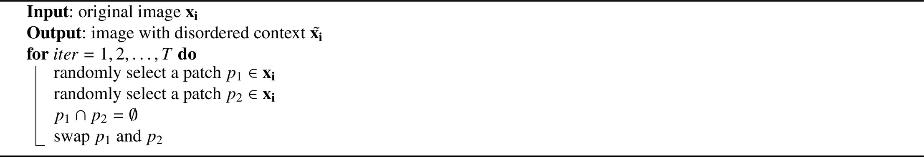
Method-CR
Context Restoration: Randomly select two isolated small patches and swap.
Major Features: 1. Simple, 2. Useful for different types of subsequent task, 3. Learn semantic features.
Experiment: Validate in classification, localization, and segmentation.

Slide 6
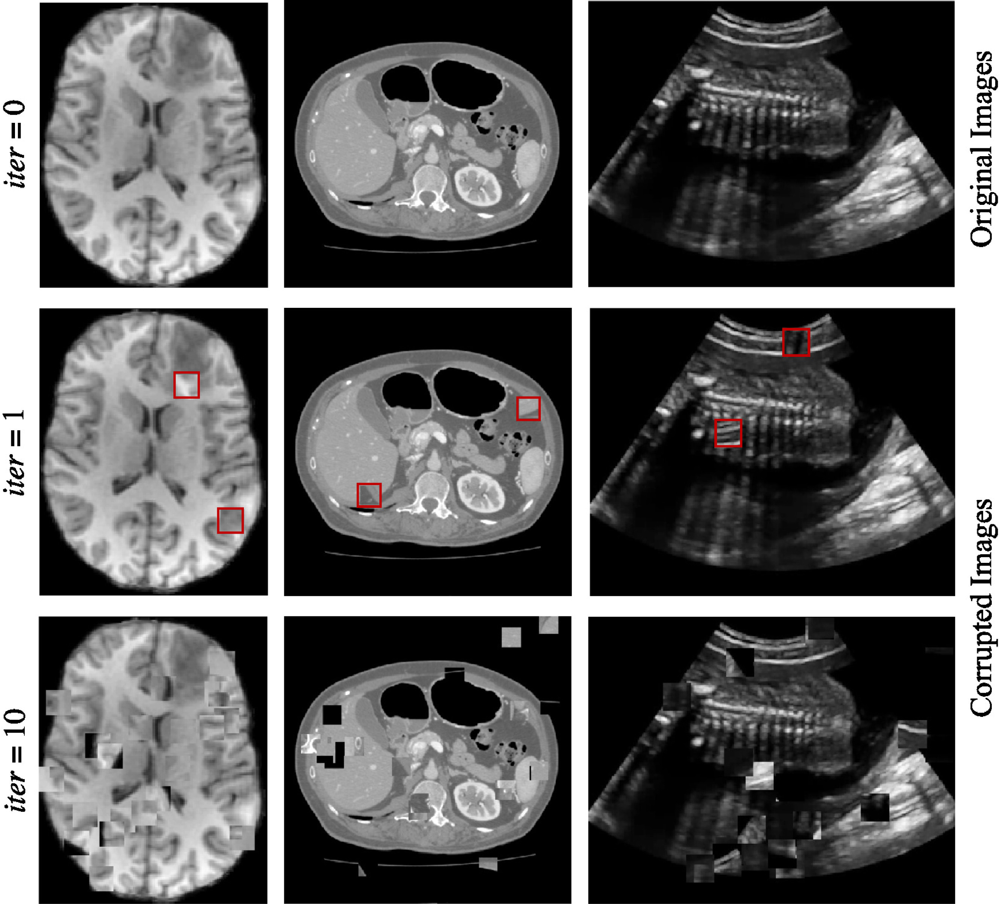
Method-CR
Generating training images for self-supervised context disordering:
Brain T1 MR image,
Abdominal CT image
2D fetal ultrasound image, respectively.

Slide 7
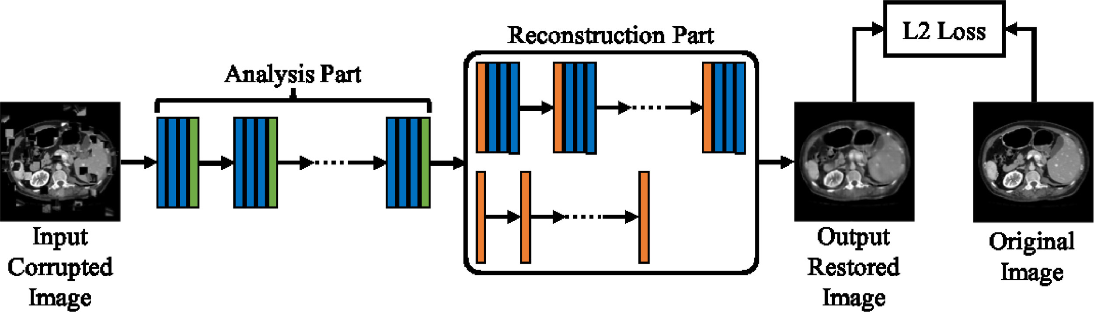
Method-Network Architectures
Analysis Part: Conv + Downsampling. E.g. ResNet,DenseNet,Inception.
Reconstruction Part: Deconv + Upsampling.
Notes:
RP Shortcomings：1.relative position has multi result. 2.CNN learn trivial features. 3. not whole picture.

Slide 8
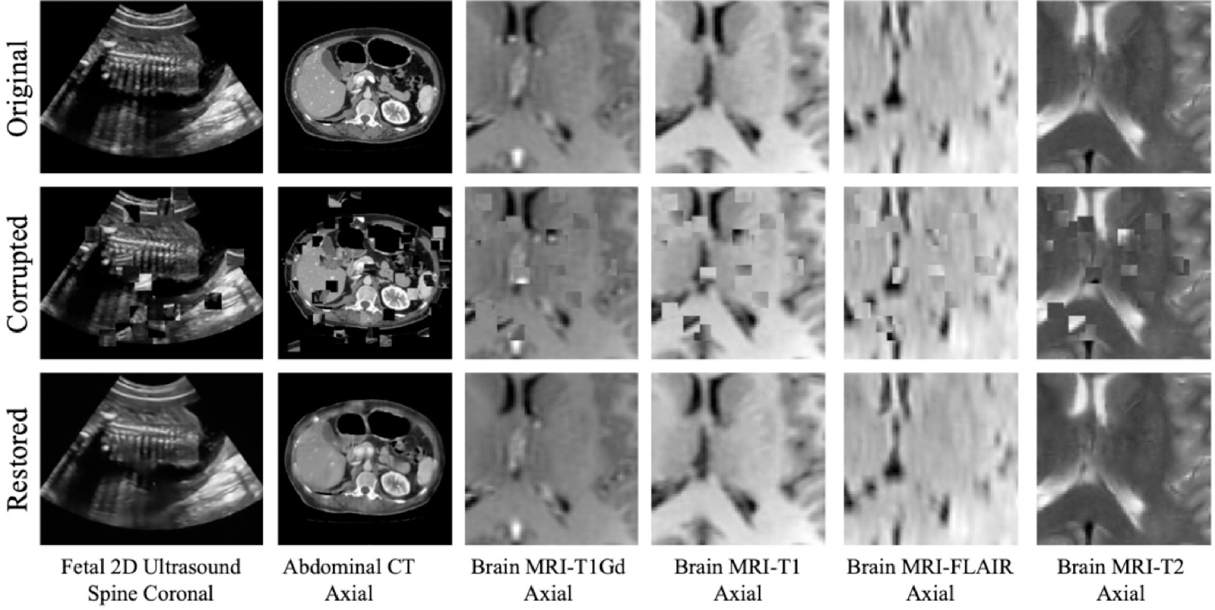
Experiment-CR
Analysis Part: VGG.
Result: Image blur(L2 loss function).
Notes:
RP Shortcomings：1.relative position has multi result. 2.CNN learn trivial features. 3. not whole picture.

Slide 9
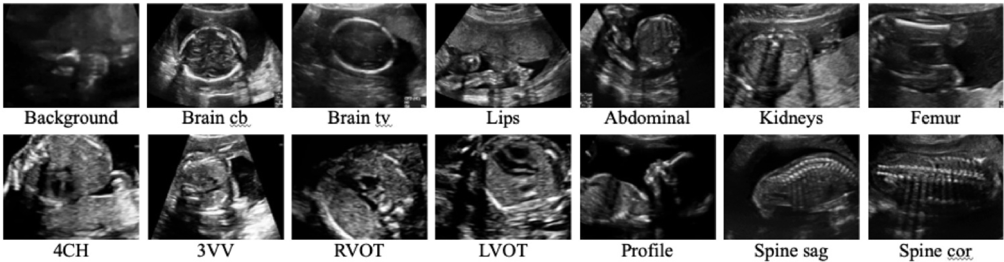
Experiment-Fetal Standard Scan Plane Classification
Network: SonoNet-64.
Dataset: 2694 2D ultrasound.
Implementation: each batch consists of two images from each of the standard scan plane cat- egories and 26 images from background images.
Notes:
RP Shortcomings：1.relative position has multi result. 2.CNN learn trivial features. 3. not whole picture.

Slide 10
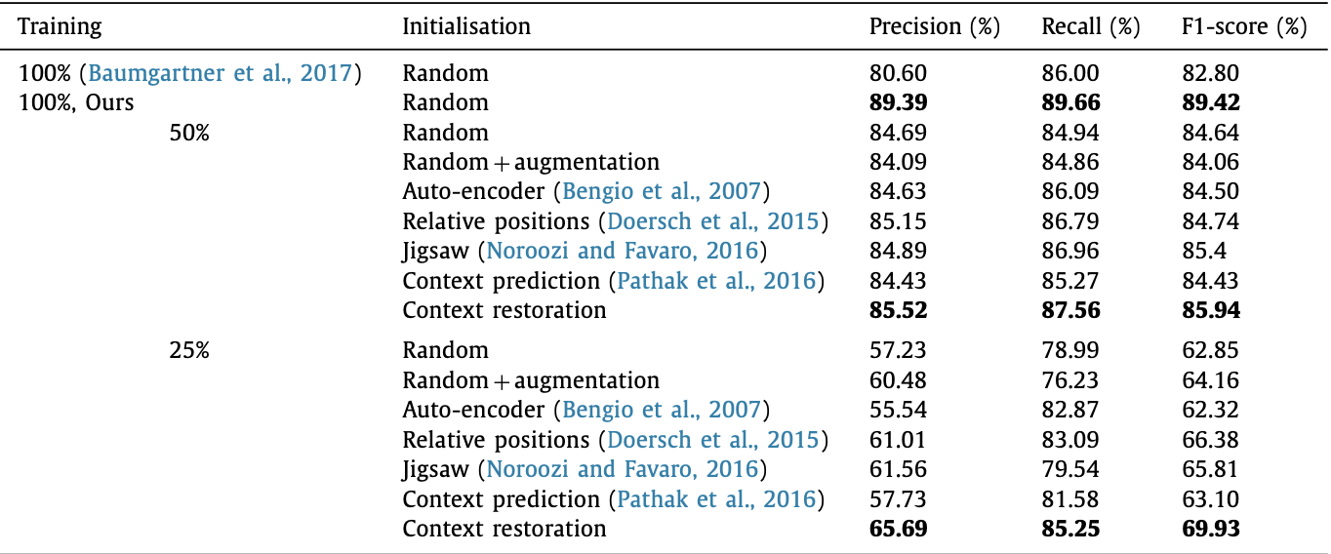
Experiment-Fetal Standard Scan Plane Classification
Less data leads to worse results.
Data Augmentation does not make improvement when training on half data but obvious a quarter of data.
SSP helps improve the result and CR is most useful.
Notes:
RP Shortcomings：1.relative position has multi result. 2.CNN learn trivial features. 3. not whole picture.

Slide 11
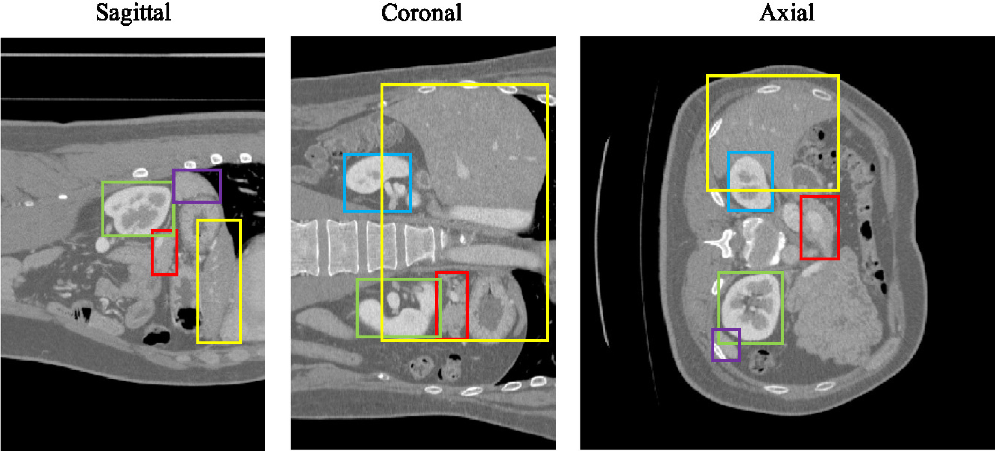
Experiment-Abdominal Multi-Organ Localization
Network: More layers.
Dataset: 3D abdominal CT image from 150 subjects.
Implementation: each batch consists of two images from each of the standard scan plane cat- egories and 26 images from background images.
Notes:
RP Shortcomings：1.relative position has multi result. 2.CNN learn trivial features. 3. not whole picture.

Slide 12
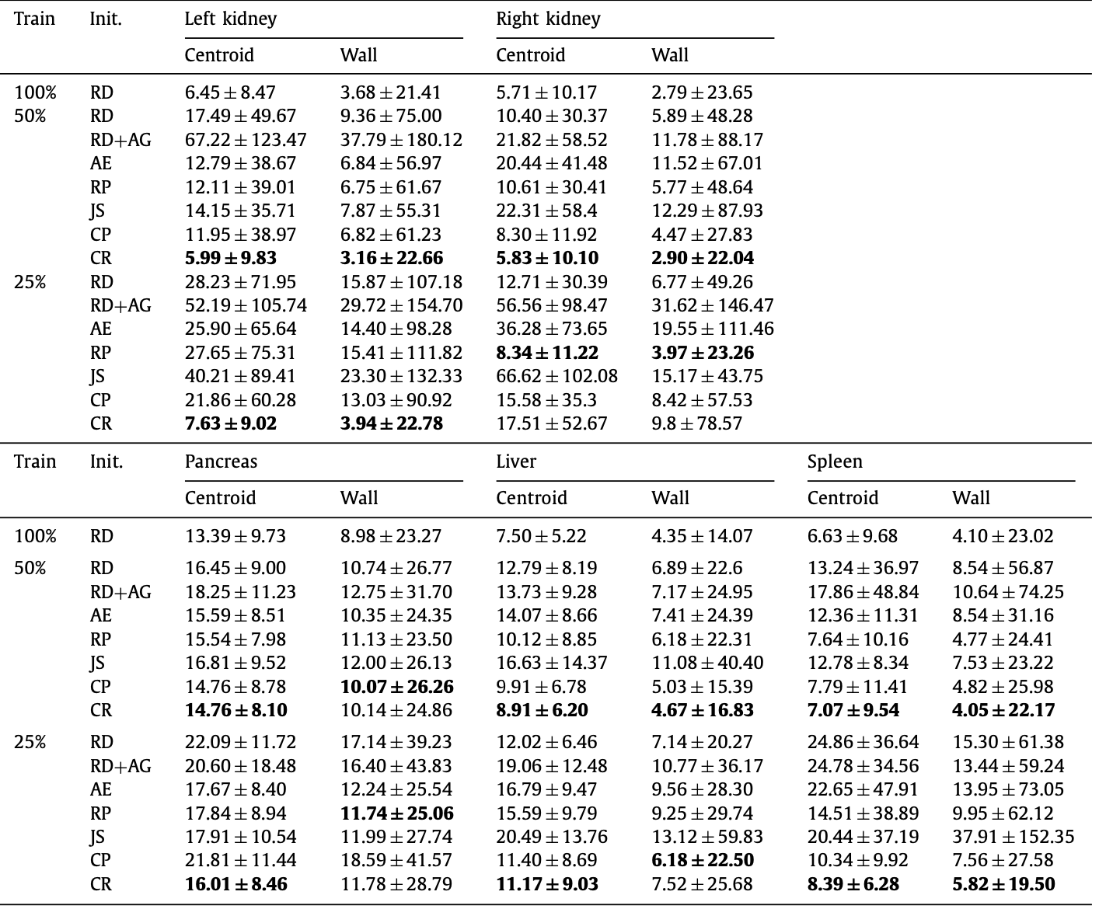
Experiment-Abdominal Multi-Organ Localization
Data Augmentation doesn’t help.
CR helps most.
Notes:
RP Shortcomings：1.relative position has multi result. 2.CNN learn trivial features. 3. not whole picture.

Slide 13
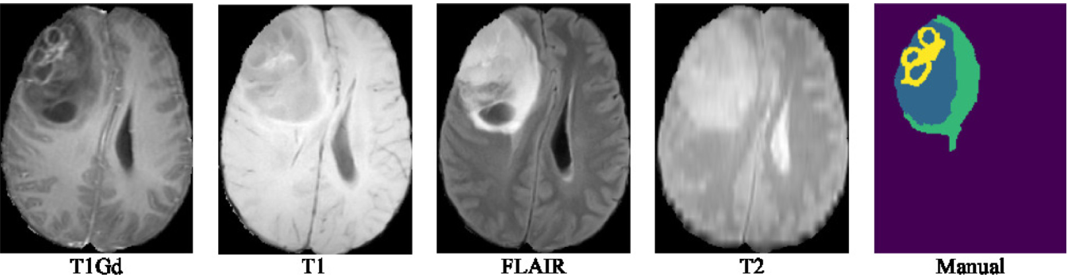
Experiment-Brain tumour segmentation
Network: Unet.
Dataset: BraTS 2017 challenge which consists of 285 subjects(four modalities).
Implementation: Based on patch with size 64*64.
Notes:
RP Shortcomings：1.relative position has multi result. 2.CNN learn trivial features. 3. not whole picture.

Slide 14
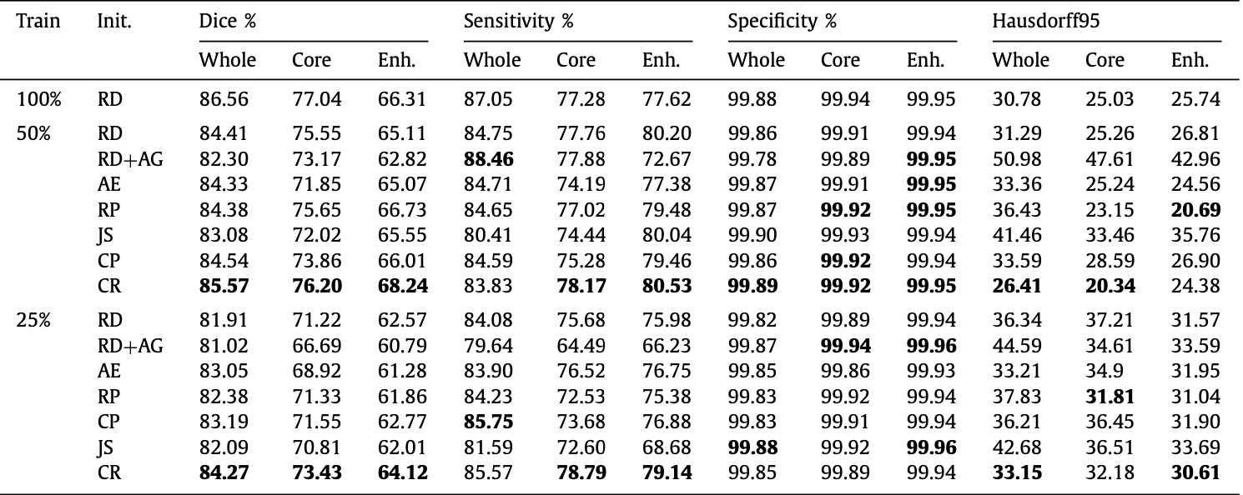
Experiment-Brain tumour segmentation
Data augmentation decrease the segmentation accuracy.
SSP helps improve the result and CR is most useful.
Notes:
RP Shortcomings：1.relative position has multi result. 2.CNN learn trivial features. 3. not whole picture.

Slide 15
Thank you (Q&A)
Notes:
RP Shortcomings：1.relative position has multi result. 2.CNN learn trivial features. 3. not whole picture.

